Slide 1
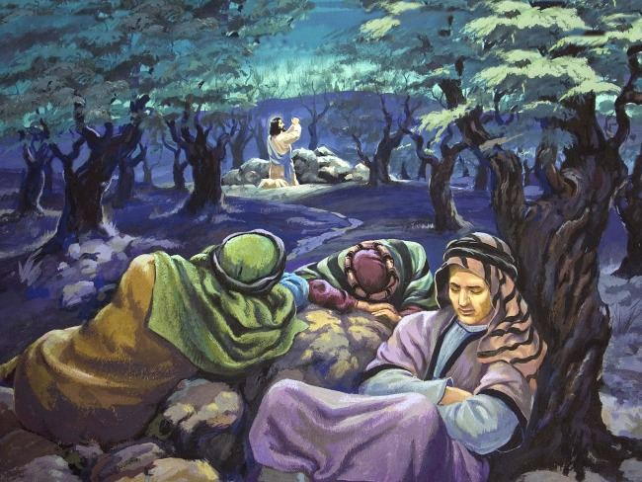
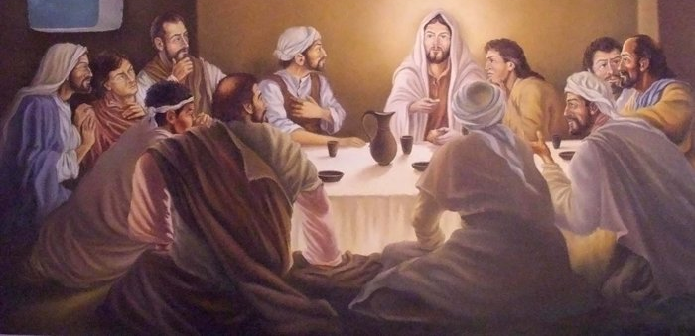
Maundy Thursday: The Last Supper and the Garden of Gethsemane
Recap: Discuss with your partner:
What happed at the last supper and in the garden?
How do you think Jesus felt when the disciples feel asleep as he was praying?
How do you think Jesus felt about facing his death to save us from our sins?

Slide 2
Learning Objectives
To understand the significance of the Last Supper.
To understand the events in the Garden of Gethsemane.
To evaluate how Jesus would have felt on Maundy Thursday.

Slide 3
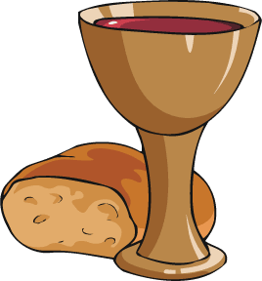
Paschal Mystery Key Word Definitions
V | E | N | W | I | K | Y | J | O | O | A | S | F | C | C
O | G | P | N | O | I | S | S | A | P | D | Z | I | H | R
P | O | N | T | I | U | S | P | I | L | A | T | E | I | U
Q | Z | V | O | V | H | Z | L | E | P | Z | P | Y | L | C
J | M | H | D | U | P | O | J | D | K | X | Y | R | A | I
X | U | Z | J | B | I | P | L | Z | B | A | Y | A | I | F
P | A | S | S | O | V | E | R | Y | A | V | E | V | N | I
Z | M | X | U | Y | O | J | T | D | W | Y | N | L | E | X
L | A | S | T | S | U | P | P | E | R | E | P | A | D | I
L | A | H | C | S | A | P | D | V | L | G | E | C | R | O
N | O | I | T | C | E | R | R | U | S | E | R | K | E | N
S | A | N | H | E | D | R | I | N | A | T | B | J | T | Z
T | N | A | N | E | V | O | C | Z | G | Q | E | W | E | I
H | T | V | U | F | E | D | Q | Y | X | J | P | D | P | C
V | L | D | T | I | Y | X | Z | F | P | D | T | Q | O | T
Sanhedrin:
Calvary:
Covenant:
Peter’s Denial:
Pontius Pilate:
Last Supper:
Resurrection:
Crucifixion:
Paschal:
Passion:
Passover:
Holy Week

Slide 4
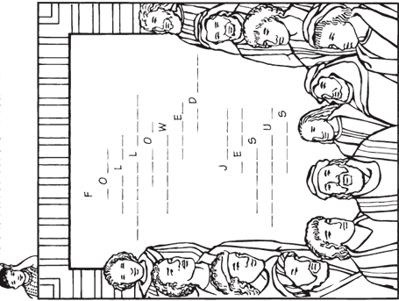
His brother Andrew was an apostle, and so were James
and John, the two sons of Zebedee.³ Philip, Bartholomew, Thomas, Matthew the tax collector, James and Thaddaeus were also apostles. ⁴ The others were Simon, known as the Eager One, and Judas Iscariot, who later betrayed Jesus.
Matthew 10:2-4
Jesus chose twelve men to follow him while he was on earth. He taught them how to continue his teaching after he went back to heaven. The disciples followed Jesus, as we should. The twelve were with Jesus at the Last Supper, Jesus told the disciples that one of them would betray him.
Look up Matthew 10:2-4 and use the names of the twelve disciples to fill in the blanks.
Remember that there were two men with the same name.
²The first of the twelve apostles was Simon, better known as Peter.
Matthew 10:2-4

Slide 5
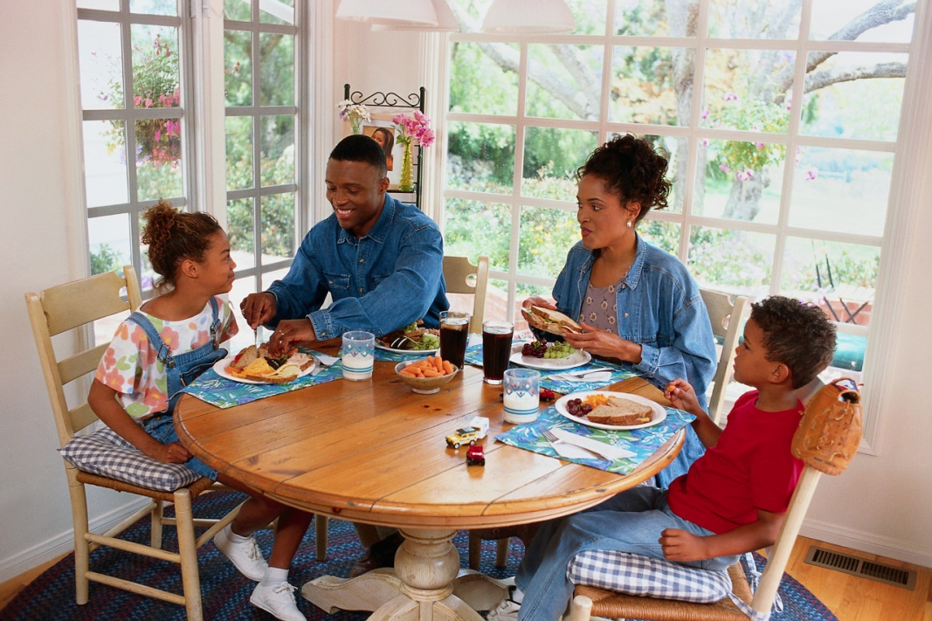
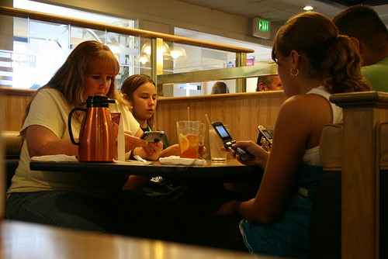
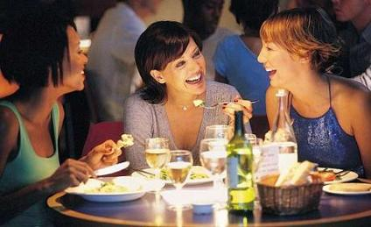
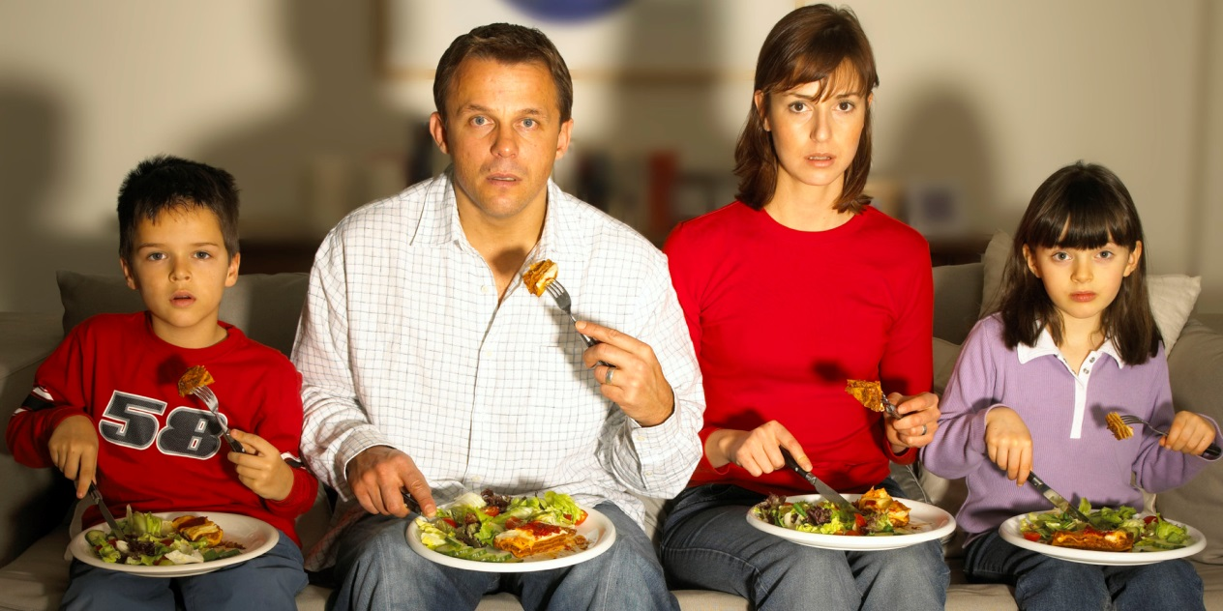
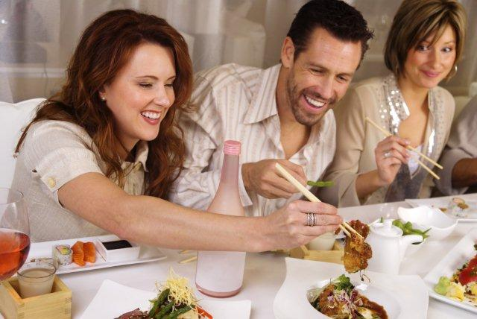
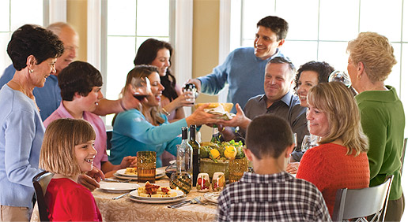
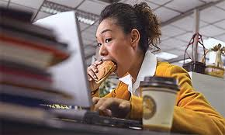
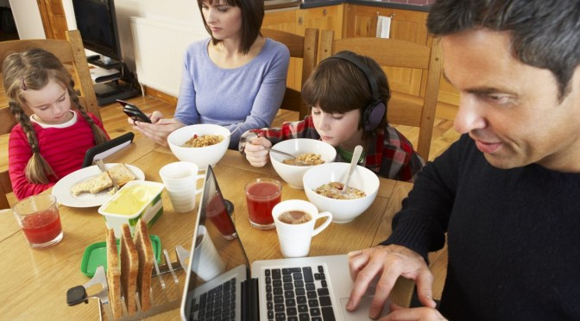
Think-pair-share
What is the difference between the meals?
Which do you think is better to create good relationships? Why?

Slide 6
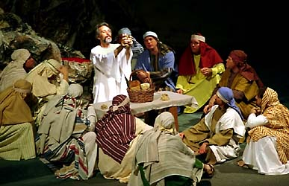
Passover – a Jewish custom of celebrating when God spared them from plague in Egypt.
Christians called it the Last supper because when Jesus celebrated the Passover with his disciples it was his last meal before his arrest and death.
Jesus shared food and drink with his disciples, he broke bread which would become his body and wine which would become his blood.
‘Do this in memory of me.’
Christians gather at the altar to share his body and blood in Mass.

Slide 8
Luke 22:39-53
Jesus Prays on the Mount of Olives
³⁹ He went to the Mount of Olives, and the disciples followed him. ⁴⁰ And when he came to the place, he said to them, “Pray that you may not enter into temptation.” ⁴¹ And he withdrew from them about a stone's throw, and knelt down and prayed, ⁴² saying, “Father, if you are willing, remove this cup from me. Nevertheless, not my will, but yours, be done.” ⁴³ And there appeared to him an angel from heaven, strengthening him. ⁴⁴ And being in an agony he prayed more earnestly; and his sweat became like great drops of blood falling down to the ground.^{[a]} ⁴⁵ And when he rose from prayer, he came to the disciples and found them sleeping for sorrow, ⁴⁶ and he said to them, “Why are you sleeping? Could you not watch one hour with me? Rise and pray that you may not enter into temptation.”
Betrayal and Arrest of Jesus
⁴⁷ While he was still speaking, there came a crowd, and Judas was leading them. He drew near to Jesus to kiss him, ⁴⁸ but Jesus said to him, “Judas, would you betray the Son of Man with a kiss?” ⁴⁹ A disciple said, “Lord, shall we strike with the sword?” ⁵⁰ And one of them struck the servant^{[b]} of the high priest and cut off his right ear. ⁵¹ But Jesus said, “No more of this!” And he touched his ear and healed him. ⁵² Then Jesus said to the chief priests and officers of the temple and elders, who had come out against him, “Have you come out as against a robber, with swords and clubs? ⁵³ When I was with you day after day in the temple, you did not lay hands on me. But this is your hour, and the power of darkness.”

Slide 9
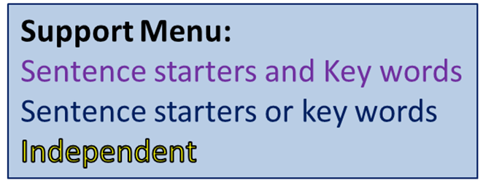
Write a diary for Jesus. Explain in the diary how the Jesus felt in the Garden of Gethsemane.
Things to include:
What events took place (brief description)
What was the Jesus doing during it/what was his role?
How did he feel when the events were taking place?
Was it easy to stay faithful and do as God asked?
Key Words
Disciple
Sanhedrin
Holy Week
Passion
Good Friday
Maundy Thursday
Pharisees
Passover
Sabbath

